Slide 1
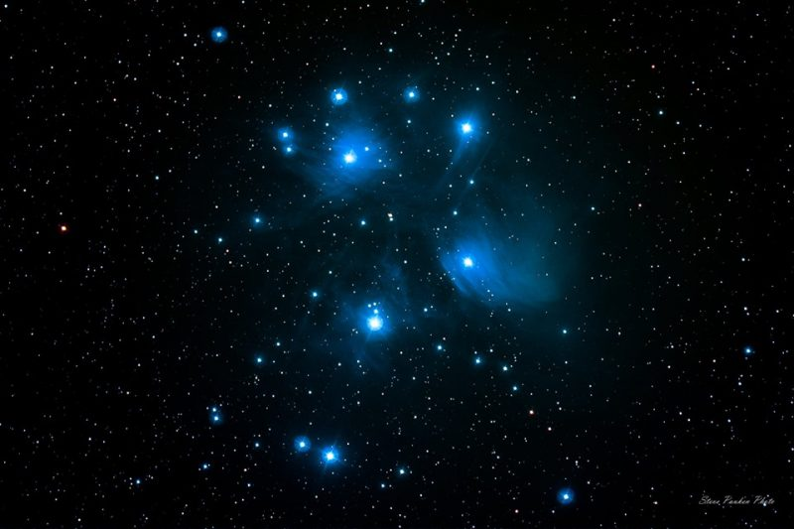
Simulating Star Cluster velocity to find general trends
By Sahil Kuwadia

Slide 2
Background Information
Stars generally form in clusters and association with other stars, rather than in isolation.
Depending on the cluster, these can be short or long lived.
This simulation was run on a super computer known as Center of Galaxy Evolution Research, by a team of researchers from Yonsei University from Seoul, South Korea.
This type of simulation is known as an N-Body simulation.
It is computationally expensive as it has a run time of O(N^2), where in is the number of particles in the simulation
The simulation has 64000 unique stars/particles.
Time is measured in standard N-Body units where G = M = -4E =1.
Distance is also measured in accordance with these N-Body Units.
The Z plane is taken into account in calculations, but not shown

Slide 3
Question
Which region of stars, by the end of the simulation, will have the highest velocity?

Slide 4
Experimental Overview
Hypothesis: By the end of the simulation the stars at the center will in general have a higher velocity than stars further out.
Independent Variable: Position of the Star
Dependent Variable: Velocity of the Star
Control: The Distributions at Time=0
Constants: The amount of stars in the simulation, the gravity and total energy of the simulation, and the total mass of the simulation
Materials: Laptop

Slide 5
Procedures
Download PyCharm, Python 3.7, required packages, and the simulation data.
Parse the simulation data and get rid of the id column
Generate X/Y plane graphs
Generate Radius and Velocity Distributions
Generate a Dendrogram to find the amount of clusters.
Generate Clusters
Compare data across time stamps

Slide 6
DATA

Slide 7
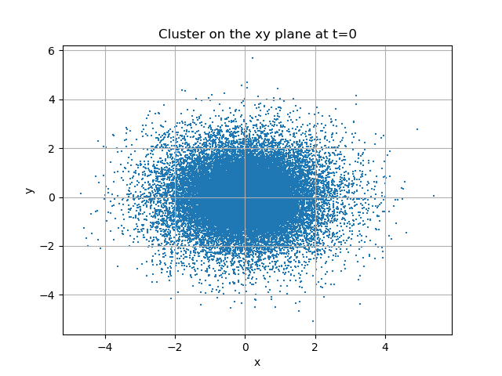
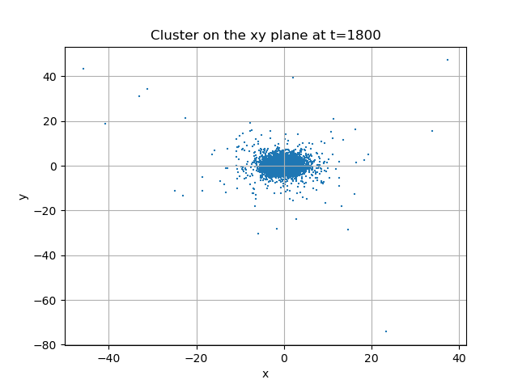
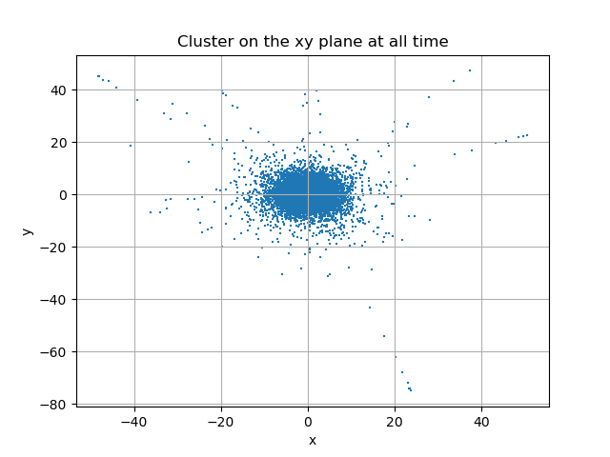
Distributions on the XY Plane

Slide 8
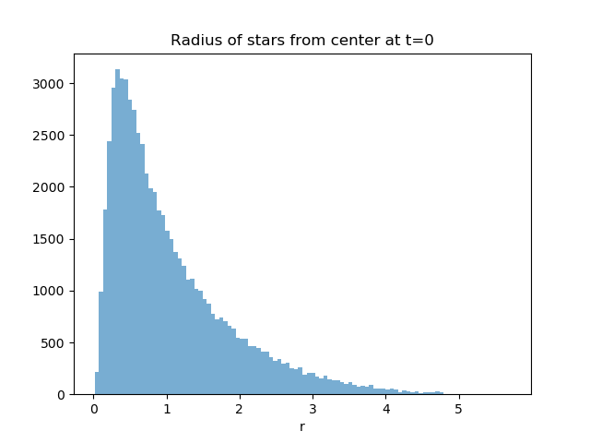
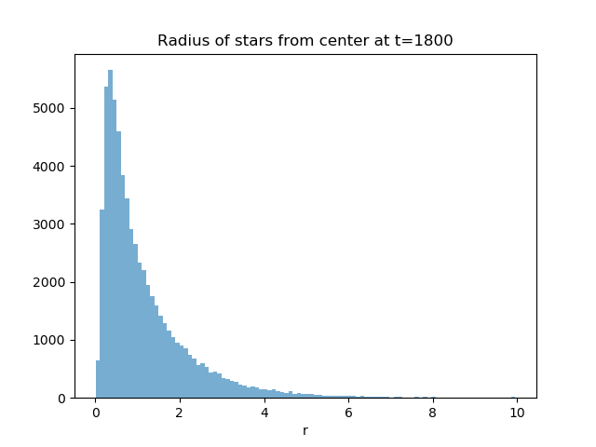
Radius Distrbutions

Slide 9
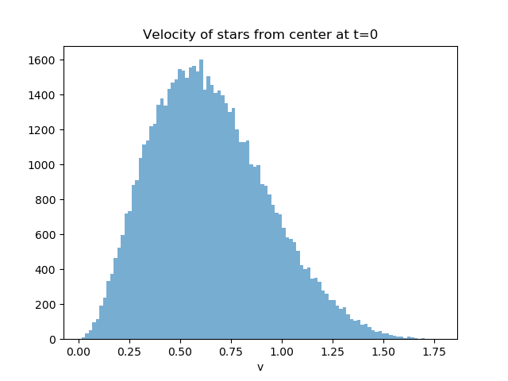
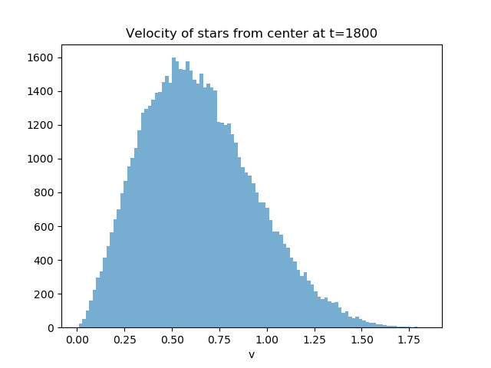
Velocity distributions

Slide 10
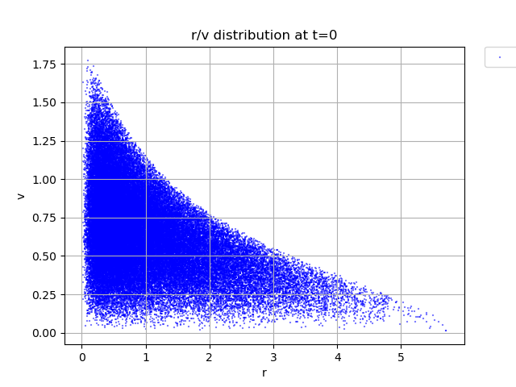
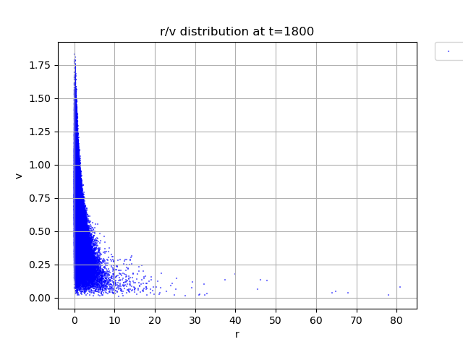
Radius vs Velocity distribution

Slide 11
A note on Hierarchical CLustering
Clustering based on how similar a “gene”, or set of data, is to another.
Uses the Euclidean distance between two points
Determined by Pythagorean's Theorem on a 2d plane
Vs K means clustering which groups based on getting the maximum variation in the cluster.

Slide 12
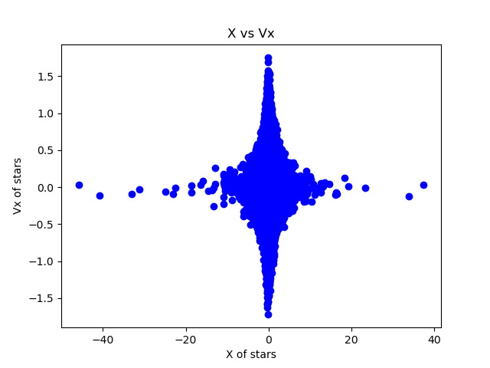
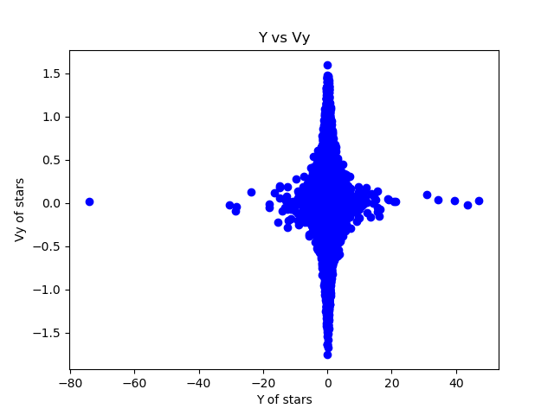
Position vs velocity

Slide 13
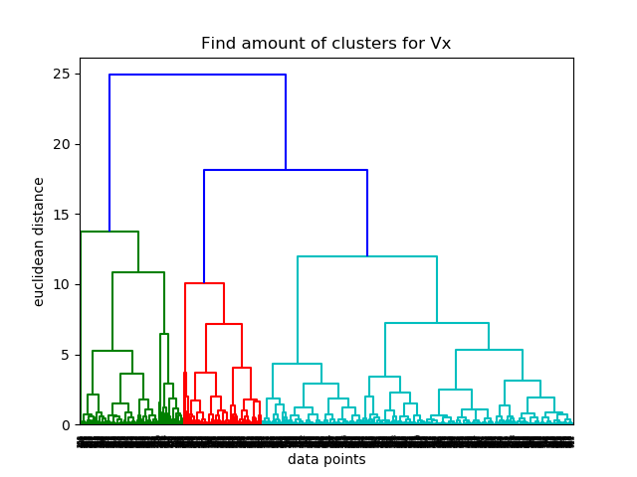
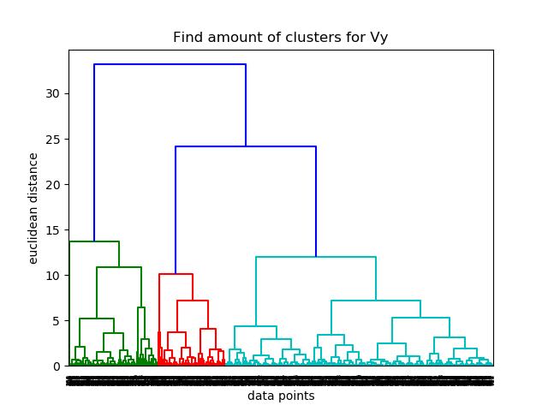
Dendrograms

Slide 14
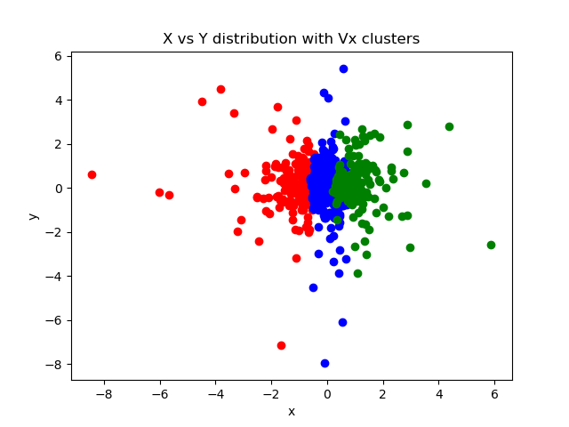
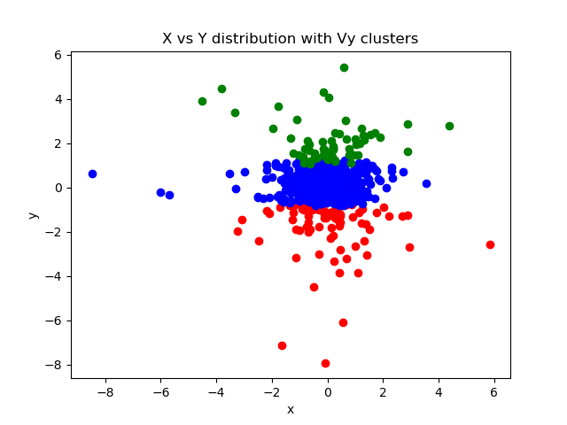
Clusters

Slide 15
Conclusion
Stars closer to the center of the cluster have a higher velocity than stars further away.
Over the course of the simulation more stars with higher velocities were around the center, while slower stars tended to move towards the outer edges of the cluster.
The initial hypothesis is valid!

Slide 16
Errors
30 stars escaped the simulation by the end.
It is not known why so I could not take that into account for any change in data.
This is a .0469% error
Due to this the total energy for of the system slightly fluctuated over time
My PC is not the most powerful so some of the calculations and graphs may be slightly off

Slide 17
Steps for the future
Run the data on a more powerful machine.
Take into account the 30 lost planets.
Look at the rest of the time intervals to look at the progression.
This data can be used to help find out why stars in certain regions are faster.
Can be used to help identify whether a cluster contains a supermassive black hole.

Slide 18
Bibliography
Heggie, D, and S Aarseth. “Star Cluster Simulations.” Kaggle, Yonsei University, 2017, www.kaggle.com/mariopasquato/star-cluster-simulations.
Schnieder, Arny. “Star Clusters.” Star Clusters, 2019, abyss.uoregon.edu/~js/ast122/lectures/lec15.html.
Reddy, Chaitanya. “Understanding the Concept of Hierarchical Clustering Technique.” Medium, Towards Data Science, 17 Feb. 2020, towardsdatascience.com/understanding-the-concept-of-hierarchical-clustering-technique-c6e8243758ec.
Garbade, Michael J. “Understanding K-Means Clustering in Machine Learning.” Medium, Towards Data Science, 12 Sept. 2018, towardsdatascience.com/understanding-k-means-clustering-in-machine-learning-6a6e67336aa1.

